Slide 1

Celia Potgieter
Enhancing Organisational Performance
through
The Science of Happiness
Positive Organisational Psychologist

Slide 2
“Botswana has a bad work ethic”

Slide 3
Maslow, 1943

Slide 4
Enhancing Organisational Performance through the Science of Happiness
Positive Psychology - The Science of Happiness
Global Trends in Happiness
Industry Trends in Happiness
Benefits of Happiness in the Workplace
How to Create a Positive Organisation

Slide 5
What is Happiness?

Slide 6
“Moments of joy, contentment or positive well-being, combined with a deep sense that one’s life is good, meaningful and worthwhile”.
Sonja Lyubomirsky

Slide 7
Happy children and adults have been shown to experience the following:
            Better performance at school
            Better performance at work
            Happier and healthier marriages
            Better physical health
            Better mental health

Slide 8
Can we Change our Happiness Levels?

Slide 9
What Determines Happiness?
Circumstances 10%
Intentional Activity
40%
Genetics
50%

Slide 10
A shift in focus from human beings at their worst,
to human beings at their best.
Based on scientific research in the fields of
psychology, sociology, business, management, and neuroscience.
The Science of Positive Psychology

Slide 11
Growth in Scientific Research

Slide 12
2008, the Kingdom of Bhutan stops measuring national development through GDP, and starts using a new measure called the Gross National Happiness Index.
2012, the first The World Happiness Report, studying happiness levels of 156 countries.
2013, Finland takes the decision to “move beyond the achievement of test scores to the development of happy and well-adjusted children and adults”
2016, the United Arab Emirates creates a Ministry of Happiness and Well-Being and introduces a national Positivity Programme.
2016, Bhutan introduces a Gross National Happiness for Business index.
2018 and 2019, Finland ranks the happiest country in the world.
2019, Finnish children post the highest scores in the OECD’s PISA education rankings - again.
2019, New Zealand has just announced that it is placing national happiness at the core of all budget spending decision-making.
Global Trends

Slide 13
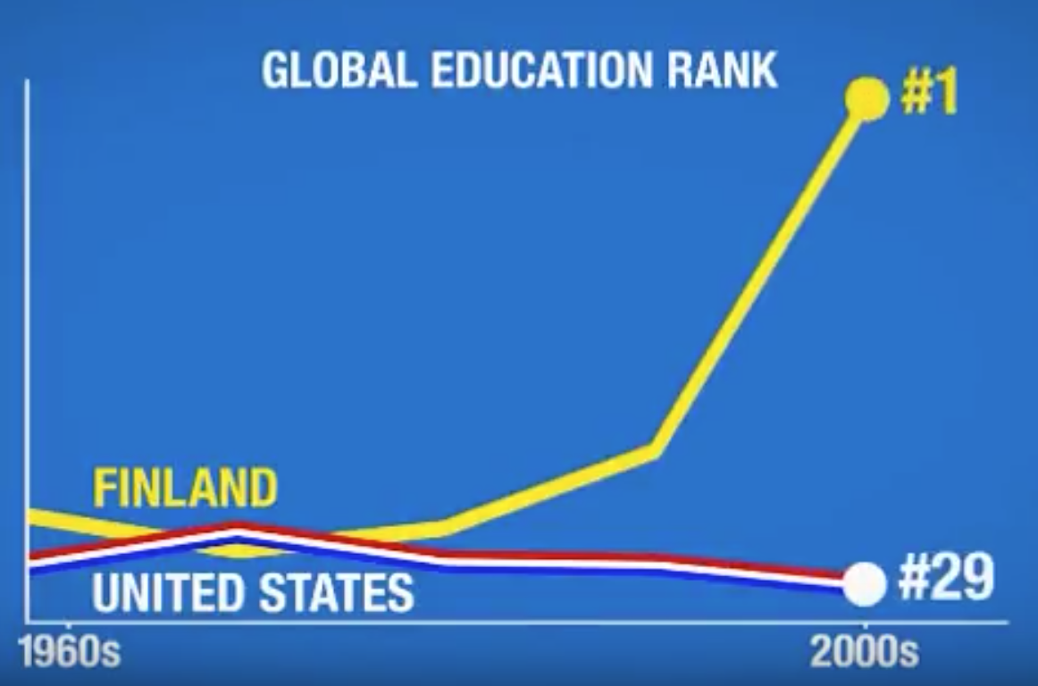

Slide 14
“Every organisation is an open system that depends on its human capital to bring its vision and purpose to life.
An organisation will cease to exist without a human system to lead and support it.”
David Cooperrider

Slide 15
“It’s all about people.”
Richard
Branson

Slide 16
“It’s not my job to make my employees feel good about coming to work”
Anonymous

Slide 17
Top Influencers of Today’s Labour Pool
Workplace Flexibility
Working with a Purpose
Commitment to Health and Well-Being
50% employees want a greater focus on well-being at work, including physical, psychological and financial wellness
Only 13% of surveyed companies offer an employee value proposition differentiated by a purpose-driven mission
84% working parents ranked workplace flexibility ahead of salary
Industry Insights
Notes:
Mercer 2018 Global Talent Trends
Collected data from:
800 business executives
1,800 HR leaders
5,000 employees
21 industries
44 countries

Slide 18
The fundamental goal of Positive Psychology in the Workplace, is to enhance lives, businesses, and communities by implementing positive tools and interventions throughout the entire employee life cycle.

Slide 20
Why?

Slide 21
Happiness at Work Reduces…
Stress and burnout
Physical and mental health challenges
Withdrawal and disengagement
Boredom and distraction
Excessive self-criticism
Incivility in the workplace
Mishaps and mistakes on the job

Slide 22
Happiness at Work Improves…
Productivity
Performance
Communication
Creativity & Innovation
Employee relationships
Employee goal setting
Customer service levels
Customer loyalty
Employee loyalty

Slide 23
Some Numbers
Research studies have demonstrated that when people are happier at work:
commitment increases by up to 73%
they are 12% more productive
sales results increase by 37%
creativity is 3 times higher

Slide 24
Job Satisfaction Surveys
What you think about your job.
A rational evaluation of your job situation.
Are you satisfied with your pay?
your hours?
your working environment?
There is a poor correlation between job satisfaction and job performance.
Satisfaction is a thought. Happiness is a feeling.

Slide 25
Employee Engagement Surveys
The relationship between you and your job
Engagement in a task – do you care about the work you do?
Engagement of self – do you bring your whole self to work?
Engagement is about your relationship to work. Happiness is about you.
Engagement can come from positive OR negative sources.
You can be engaged AND unhappy ----→ This leads to BURNOUT.
“I want you to be more engaged!”

Slide 26
Employee Motivation
No-one can be just simply motivated or demotivated.
All motivation is in relation to a given task.
Motivation can be positive or negative
5 Levels of Motivation
Extrinsic
Introjected
Identified
Integrated
Intrinsic
We are motivated to do the work that makes us happy.
Notes:
Extrinsic (motivated by gaining reward through pay, bonuses etc, or by avoiding punishment)
Introjected (internal pressure such as guilt, anxiety)
Identified (understanding the reason why something needs to get done)
Integrated (personally buying into the need to do something)
Intrinsic (wanting to do it for the sake of doing it)

Slide 27
P
E
R
M
A
H
Positive
Emotions
Engagement
Positive
Relationships
Meaning
Achievement
Health & Vitality
The right balance of heartfelt positivity to build our resilience
The regular development of our strengths – those things we are good at and enjoy doing
The creation of authentic, energising and supportive relationships
A sense of being connected to something bigger than ourselves
The self belief and ability to pursue and accomplish goals
Eating well, moving regularly and sleeping deeply

Slide 28
P
Positive
Emotions
The right balance of heartfelt positivity to build our resilience
Notes:
Make it your mission to positively affect someone’s emotions.
E.g. 1: My Name
E.g. 2: Call on someone in the audience
E.g. 3. The 7 Second Smile Challenge
E.g. 4: Giving doctors sweets – 12% better diagnosis accuracy

Slide 29
Celia Boitshepo Potgieter

Slide 30
P
Positive
Emotions
The right balance of heartfelt positivity to build our resilience
Notes:
Make it your mission to positively affect someone’s emotions.
E.g. 1: My Name
E.g. 2: Call on someone in the audience
E.g. 3. The 7 Second Smile Challenge
E.g. 4: Giving doctors sweets – 12% better diagnosis accuracy

Slide 31
E
Engagement
The regular development of our strengths – those things we are good at and enjoy doing
Notes:
What are strengths?
What are the benefits of using our strengths?
Realised, Unrealised, Learned Behaviours, and Weaknesses
Strength Spotting in your team

Slide 32
R
Positive
Relationships
The creation of authentic, energising and supportive relationships
Notes:
E.g. 1: Google cafeteria
E.g. 2: The Losada Ratio

Slide 33
M
Meaning
A sense of being connected to something bigger than ourselves
Notes:
E.g. 1: Fundraisers meeting a beneficiary – 182% increase in results

Slide 34
A
Achievement
The self belief and ability to pursue and accomplish goals

Slide 35
H
Health & Vitality
Eating well, moving regularly and sleeping deeply

Slide 36
Case Study - ZAPPOS: HAPPINESS IN A BOX
“Zappos is about delivering happiness to the world.”
Tony Hsieh, Chief Executive Officer, Zappos
A Tale of Two CEOs
Nick Swinmurn’s goal - to build the next internet retailing powerhouse, and to satisfy customers’ needs faster and more simply than ever before
Tony Hsieh’s goal – to create a culture focusing on employee happiness

Slide 37
Case Study - ZAPPOS: HAPPINESS IN A BOX
Tony Hsieh’s driving force:
”What kind of company can we create where we all want to be there, including me?
How can we create such a great environment, where employees get so much out of it that they would do it for free?”
This led to a culture focused on delivering happiness to both customers and the greater public.

Slide 38
Case Study - ZAPPOS: HAPPINESS IN A BOX
Cultures come from somewhere. They are made, not born.
In 2004, Zappos asked all of its employees to provide their thoughts on what the Zappos culture meant to them.
This feedback was compiled into a culture book.
This book is added to, and published every year with new employee comments.
Zappos’ employees understood that they were building the culture.
In 2005, Zappos hired a full-time life coach.

Slide 39
Case Study - ZAPPOS: HAPPINESS IN A BOX
In 2006, the company consulted with all its employees to define its core values.
1. Deliver WOW Through Service
2. Embrace and Drive Change
3. Create Fun and a Little Weirdness
4. Be Adventurous, Creative and Open-minded
5. Pursue Growth and Learning
6. Build Open and Honest Relationships with Communication
7. Build a Positive Team and Family Spirit
8. Do More with Less
9. Be Passionate and Determined
10. Be Humble

Slide 40
Case Study - ZAPPOS: HAPPINESS IN A BOX
“We only hire happy people, and we try to keep them happy.
Our philosophy is that you can’t have happy customers without having happy employees and you can’t have happy employees without having a company where people are inspired by the culture.”
Alfred Lin, CFO
Example interview questions:
“On a scale of 1 to 10, how lucky are you?”
“On a scale of 1 to 10, how weird are you?”

Slide 41
Case Study - ZAPPOS: HAPPINESS IN A BOX
The company offered courses on communication, finance, time management, and The Science of Happiness.
In 2009, the company’s brand promise evolved from “personal emotional connection” to “delivering happiness.”
This was grounded in the following framework, proven to help individuals and organisations how best to reach happiness:
Perceived Control
Perceived Progress
Connectedness
Vision/Meaning

Slide 42
Case Study - ZAPPOS: HAPPINESS IN A BOX
Perceived Control
Instead of annual increments, which the employees had no control over, the company implemented a “skill sets” system.
20 different skill sets that employees could acquire.
Mastering each one came with a small pay increase.

Slide 43
Case Study - ZAPPOS: HAPPINESS IN A BOX
Perceived Progress
Zappos changed its merchandising promotion process from every 18 months to smaller promotions every 6 months.
Employees reached the training, certification and compensation milestones on the same schedule.

Slide 44
Case Study - ZAPPOS: HAPPINESS IN A BOX
Connectedness
Hsieh encouraged employees to socialise outside of work.
Managers were required to spend 20-30 percent of their time ‘hanging out’ with their team members.
Part of the way you build company culture is hanging out outside of the office.

Slide 45
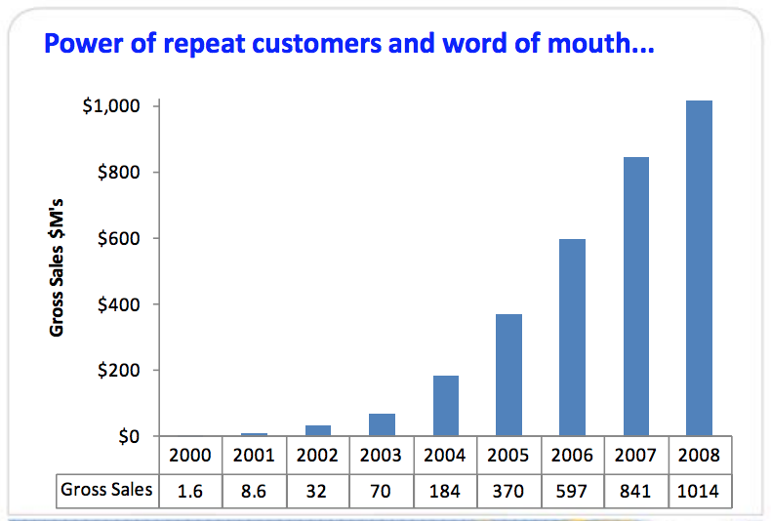
Case Study - ZAPPOS: HAPPINESS IN A BOX
The Power of Leading with Happiness
$1.2 billion

Slide 46
Enhancing Organisational Performance through the Science of Happiness
Positive Psychology - The Science of Happiness
Global Trends in Happiness
Industry Trends in Happiness
Benefits of Happiness in the Workplace
How to Create a Positive Organisation

Slide 47
THANK YOU
celia@positiveperformance.co.bw

